Slide 1
Health Outcomes Across States: Evaluating Insurance and Preventative Care
Karthika Prasad, Tammy Hardman, Katherine Gonzalez, Elaine McCall
Notes:
Potential titles:
Health Outcomes Across States: Evaluating Insurance and Doctor Visits
State-Level Health Outcomes: The Influence of Insurance and Doctor Visits
Impact of Insurance and Doctor Visits on Health Outcomes at the State Level
Effects of Doctor Visits and Health Insurance on Health Outcomes
Can we doubt the lifesaving potential of regular doctors' visits? How are states preserving life?
HealthEquity :Understanding Healthcare Disparities and Mortality

Slide 2
INTRODUCTION
Our project aims to show the impact of health insurance and regular doctor visits on health outcomes at the state level for the years 2018-2019.
Healthcare Industry
In a well-functioning health system, premature deaths (under the age of 75 years) can often be avoided through public health interventions or quality medical care.
As a measure, it can help compare the performance of healthcare systems, exemplified by the World Health Organization Health Report.
Premature mortality can explain relationship between the health and wealth of nations, healthcare accounts for 10 percent of gross domestic product (GDP) of most developed nations.
Analyzing the correlation between the lack of health insurance, regular doctor visits, and premature mortality indicators is a resourceful approach for examining state health outcomes.
Notes:
U.S. healthcare spending grew 2.7 percent in 2021, reaching $4.3 trillion

Slide 3
Project Goals
Determine the impact of not having insurance and/or not using a primary source of care on health outcomes
Explore the correlation between the percentage of uninsured individuals and premature mortality rates per state
Identify the Top and Bottom 5 states
Is there a correlation between the percentage of uninsured adults and premature mortality rates per state?
Which has more influence on health outcomes, not having insurance or not having a primary source of care?
What are the Top and Worst 5 state rankings?
Next Steps

Slide 4
DATA COLLECTION
Data collected from: CDC National Vital Statistics System (NVSS)
Source: The Commonwealth Fund
Datasets used (5 csv files):
Percentage of Adults visit Reg Doctors (524 rows)
Avoidable Deaths per 100k Population (160 rows)
Preventable Deaths per 100k Population (160 rows)
Treatable Deaths per 100k Population (160 rows)
Percentage of Uninsured Adults (523 rows)
Notes:
ADD TO SLIDE IF TIME ALLOWS:
problems that arose and how you resolved them
U.S Census dataset
Cleaning process was more advanced than our project required us to?

Slide 5
DATA COLLECTION
Premature mortality refers to fatalities that occur before reaching the average age of death in a specific population. In the United States, the average age of death is approximately 75 years [NIH]. The following are three measures for exploring premature mortality to keep the life expectancy standard.
Avoidable deaths: According to Tobias, M., & Jackson, G. (2001), not every condition can be entirely avoided. Instead, what’s considered ‘avoidable’ depends on how preventable or treatable a condition is.
Preventable deaths: deaths which could have been avoided by public health interventions focusing on wider determinants of public health, such as behavior and lifestyle factors, socioeconomic status, and environmental factors [WHO]
Treatable deaths: refer to untimely fatalities that could have been averted through timely and effective health care interventions, including secondary prevention and treatment [WHO]
Notes:
How are states preserving life? Or sustaining life expectancy standard?

Slide 6
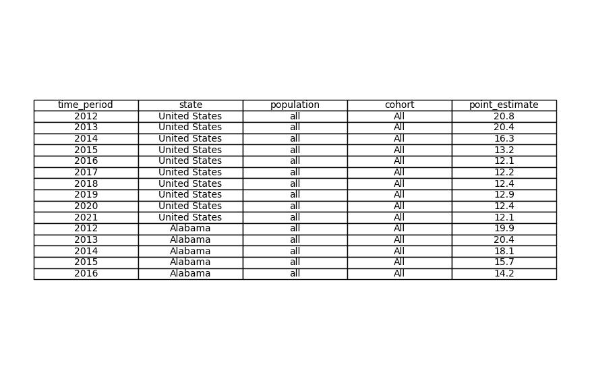
Initial look at a Dataset
Notes:
Our first initial look at our dataset that we pulled in looked like this.
Where we have multiple years for each location.
As well the columns were named the same for each dataset

Slide 7
CLEAN UP PROCESS
2018-2019
Two years of data are combined to ensure adequate sample size for state-level rates.
Two of the datasets had 2018 and 2019 separated, we averaged the years
The other three datasets had two combined years for data.
“Two years of data are combined to ensure adequate sample size for state-level rates” -The Commonwealth Fund
Why not 2020?
As 2020 brought in covid-19, we observed a jump in premature deaths vs 2018-2019 years.
Each dataset contained at least 52 rows for states - No empty (n/a) data
United States
taken out as having the average for the data - dropped based on index
50 States
Kept all, outliers are relevant
District of Columbia
Kept so we have a total of 51 “states”
Notes:
Now for our cleanup process/
After we did the initial read in of the CSVs and viewing the data
We narrowed down to the two years we will be looking at 2018 and 2019
A few things we had note of,
Of our five datasets, two of them had every year separated while the other three has them combined. We averaged the two years.
We renamed columns for ease of reading, as well as defera…. From one percentage to another.

Slide 8
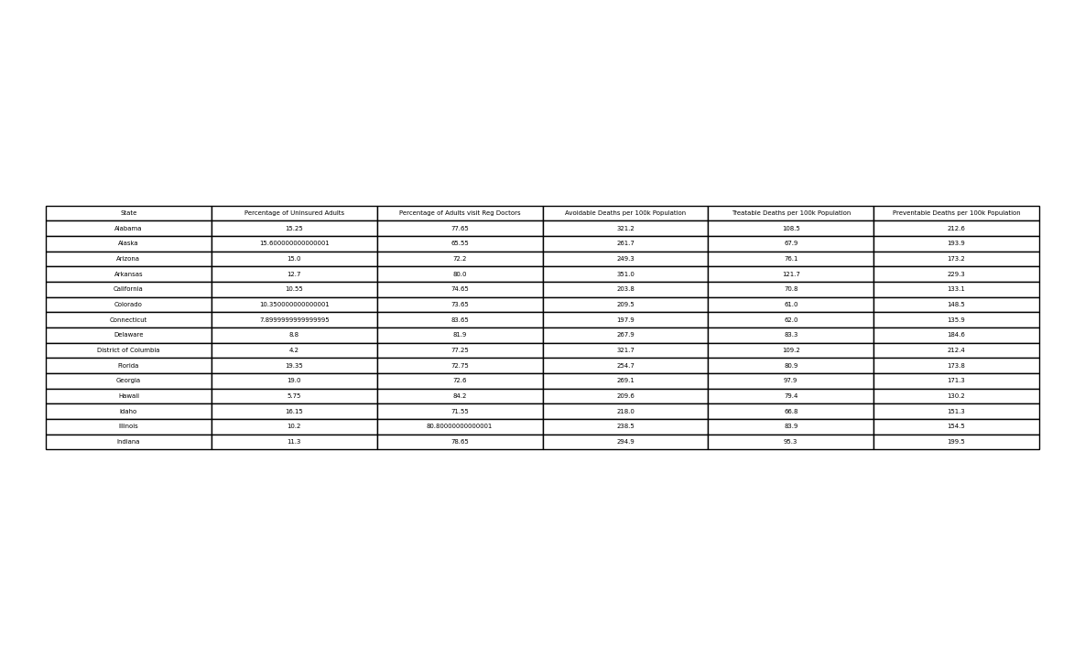
Dataset after Cleaning
Notes:
This is our dataframe that combines all 5 datasets lined up by state after cleaning ready for analyzing

Slide 9
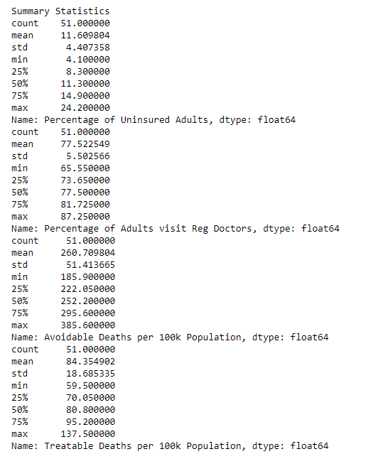
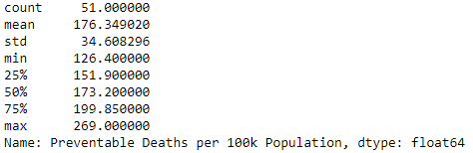
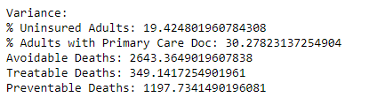
EXPLORATORY DATA ANALYSIS (EDA)
Minimum
Maximum
Standard Deviation
Variance
Notes:
We can put code here - just on the slide to show the .describe() and the .var() used to analyze this data.
We should briefly touch on if data is skewed — normal distribution of data wasn’t as important here (Discuss more with Mindie/Willis on whether this does matter??)
—----------------------------------------------------------------------------------------------------------------------------------------
Statistical significance:
Mean
Standard Deviation
Why it’s okay that our datasets are not evenly distributed nor have small standard deviations
Dataset types (all separated by states):
(2) % based
-being % based limits range of the data from 0 to 100 (for our datasets)
-so the VARIANCE is expected to be relatively smaller than our 100k population datasets
(3) 100k population
Problem(s):
-we cannot do a 1:1 comparison of the states, which we found the correlation
Pearson correlation coefficient (often denoted as "r")
-1 to 1 – the larger the number, the stronger the correlation.
If there is a positive correlation or negative correlation typically indicates that the factors you’re comparing do have an affect on one another. The stronger the correlation, the more direct that factor appears to influence the outcome.
Weaker correlations indicate that there are likely other factors involved.

Slide 10
Is there a correlation between the percentage of uninsured adults and premature mortality rates per state?
Notes:
To follow up on our conclusion of not having insurance has a larger effect on avoidable, preventable, and treatable deaths than not having a primary source of care.
we ask: <Does having health insurance lead to better health outcomes> under the assumption that not having insurance potentially prevents seeking any type of health care.

Slide 11
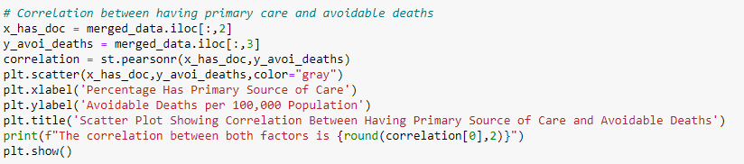
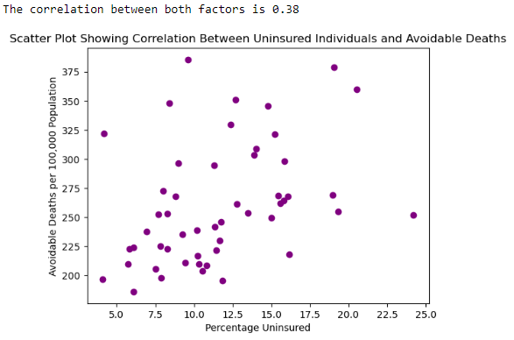
The Pearson correlation coefficient (r) is the most common way of measuring a linear correlation. It is a number between –1 and 1 that measures the strength and direction of the relationship between two variables.
https://www.scribbr.com/statistics/pearson-correlation-coefficient/
Notes:
Disproving the negative
List all the correlation values

Slide 12
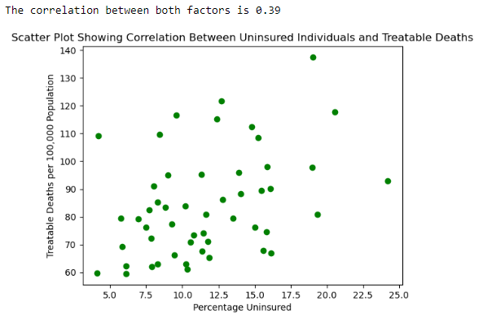
Notes:
Interestingly enough, when comparing treatable to preventable, the graphs looked identical to me, but the correlation factor was 0.35 instead of 0.39.

Slide 13
Q1 - Conclusion
Conclusion:
Limitations:
Problems:
That we couldn’t do the 1-to-1 comparison – correlation coefficient resolved this issue
Notes:
Problems, how we resolved them, limitations
By comparison, we can conclude not having insurance has a larger effect on avoidable, preventable, and treatable deaths than not having a primary source of care.
Further, the indication is that not having insurance potentially prevents seeking any type of health care.
Transition: Moderate correlations make us think there are other factors involved – one such factor might be whether or not they have a primary care doctor in order to access preventable care options.

Slide 14
Which has more influence on health outcomes, not having insurance or not having a primary source of care?
Notes:
Reasoning:
Our assumption is that having health insurance encourages individuals to seek medical care. However, we wanted to distinguish between having insurance and actively seeking preventive care to determine whether the insured are not only accessing healthcare but also experiencing improved health outcomes.
Citation: “In expansion states, people who would otherwise be in the Medicaid coverage gap had increased health insurance coverage, lower rates of avoiding seeking medical care, and greater utilization of certain preventive care measures.”

Slide 15
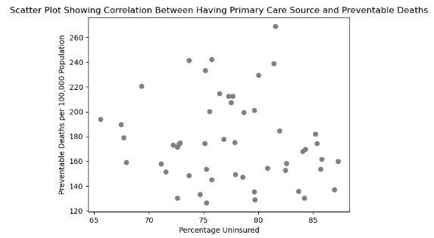
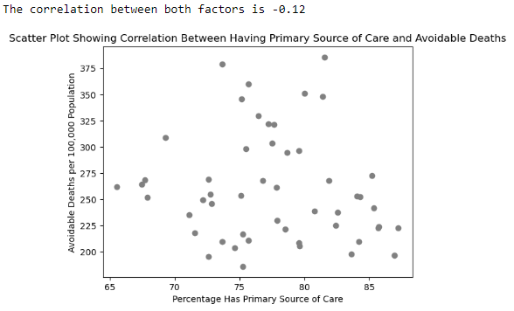
Q2 - VIZ 2
Notes:
To explore that, we will take a look at this comparison:
The correlation factor comparing the percentage uninsured to each of the premature mortality datasets (avoidable, preventable, and treatable deaths) showed the correlation factor between positive 0.3 and 0.4. It’s low enough it’s certainly not the only factor, but certainly there is a strong indication not having insurance contributes to higher premature mortality.
Whereas comparing each of the premature mortality data sets to the percentage of adults that have a primary care provider, there was a very small correlation.
By comparison, we can conclude not having insurance has a larger effect on premature mortality rates per state than not having a primary source of care.

Slide 16
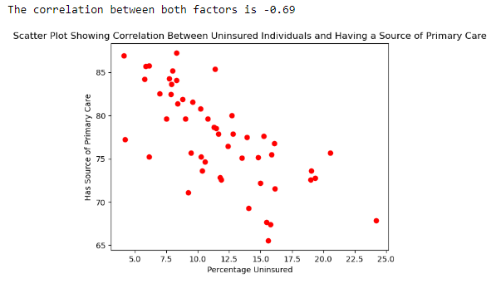
Notes:
As discussed, we used Pearson correlation coefficient to explore the data further here.
We found that there was a high negative correlation factor (-0.69) between not having insurance and having a primary source of care. Meaning someone without insurance is less likely to seek care from a primary care source which indicates lack of seeking preventive care.
Which begs the question, does lack of insurance prevent seeking just preventative care, or health care all together?

Slide 17
Q2 - Conclusion
Conclusion: Having insurance has a greater impact on positive health outcomes than having a primary care provider alone.
Problems: One significant challenge we encountered at this stage was the multitude of other factors influencing positive health outcomes. To address this, we had to focus on premature death.
Limitations: This is only one factor. While we confirmed having health insurance correlates to less premature deaths, we do not know that it is the highest correlating factor. Other factors we could explore include differences in state policy and healthcare systems. Especially focusing on particularly well versus poor performing states.
Notes:
Limitation: This is only one factor. While we confirmed having health insurance correlates to less premature deaths, we do not know that it is the highest correlating factor.
Problems: The main “problem” we had at this point was the sheer amount of other factors that contribute to more positive health outcomes, we had to focus on premature death
EMPHASIS TRANSITION: We ruled out having primary care doctor as one correlation factor. Other factors we could explore include differences in state policy and healthcare systems. Especially focusing on particularly well versus poor performing states.

Slide 18
What are the Best and Worst 5 State Rankings?
Notes:
TRANSITION (Reason for the question): As Tammy said, one of the factors we can look at are states that are performing particularly well -part. Poorly
If we identify which were the best and worst states

Slide 19
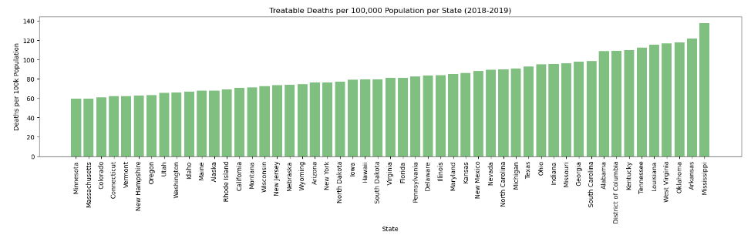
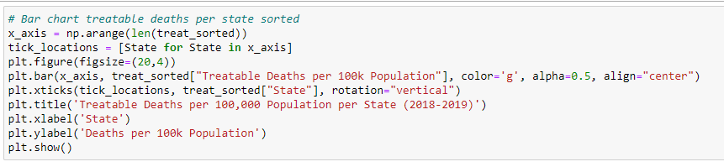
Notes:
Pretty print ++ reorder
—-----------------------------------------------------------------------
So our initial thoughts were to create a bar chart to <> … the issue we ran into this was compare the
Top bottom comparison with code to the side
Issue with this method: Comparing side-by-side was difficult and a bit too much scrolling. We used our sorted data and did a “state by step in our for loops”
We got great visuals to indicate the states that we wanted to focus on the reasons of the ranks for future explorations
Steps further to reflect an easier by side comparisons, creating dataframes that had the sort order and index to show proper ranking

Slide 20
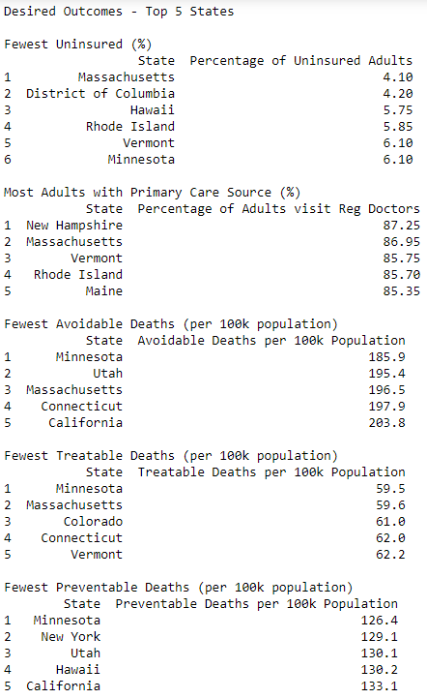
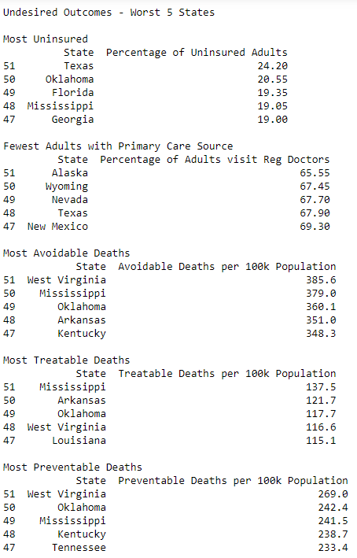
Desired Outcomes
Undesired Outcomes
Notes:
—-----------------------------------------------------------------------------
The comparison of most and least underinsured in our data Doctor Visits had to flipped to answer our research question
Desired outcomes - least amount of avoidable deaths, fewest uninsured adults, most adults with regular primary care
Undesired Outcomes - opposite, least avoidable deaths, most uninsured adults, fewest adults with regular primary care
What are the actual top 5 and bottom 5
Tie for 5th place for Fewest Uninsured - Minnesota listed as 6th ranking, but 6.10 same as Vermont
Insights:
Highlight which states show up in multiple datasets

Slide 21
Q3 - Conclusion
Conclusion:
Limitations:
Problems: Had to sort the data and one issue I ran into was that I thought the data was sorted high to low
Replicable differences?
>Can’t replicate Harvard
>Maybe can replicate successful policies
Notes:
Conclusion:
Problems: Understanding desirable versus undesirable outcomes, learning to flip the order of .head() and .tail() displays

Slide 22
CONCLUSION
Desired outcomes
Lower uninsured rates correlate with fewer avoidable, treatable, and preventable deaths overall.
Positive correlation (0.39) between uninsured adults and treatable deaths, emphasizing health insurance impact.
Preventative care access linked to lower avoidable deaths.
Undesired outcomes
Strong negative correlation (-0.69) between uninsured adults and preventative care access.
Less pronounced correlation between primary care access and treatable/preventable deaths.
Limitations
The analysis is based on data from 2018-2019, which represents a relatively short time frame and does not provide the opportunity to analyze long-term trends.
Notes:
Conclusion:
We were able to answer with our dataset, statistical significance
We showed that having health insurance positively impacts health outcomes, including lessening premature deaths and seeking preventative care.
For Uninsured individuals and Health Outcomes: Significant variation in uninsured adults across states.
Lower uninsured rates correlate with fewer avoidable, treatable, and preventable deaths overall.
-Positive correlation (0.39) between uninsured adults and treatable deaths, emphasizing health insurance impact.
-Strong negative correlation (-0.69) between uninsured adults and preventative care access.
Uninsured individuals have limited access to primary care.
Preventative care access linked to lower avoidable deaths.
Less pronounced correlation between primary care access and treatable/preventable deaths.
Limitations:
2018-19 - covid affected these outcomes – overloading the healthcare system – need trends overtime to better understand how strongly factors changing affect the outcome
Predictive analysis
Many factors that affect health outcomes – income, socioeconomic status, health care policies of each state, insurance laws per state
Medicare expansion, Affordable Care Act
Next Steps: The COVID-19 pandemic, and atypical event that affected healthcare outcomes
Takeaways:
-There is a strong negative correlation between the percentage of uninsured adults and the percentage of adults with a primary care source, suggesting that uninsured individuals are less likely to have access to primary care. Additionally, there is a positive correlation between the percentage of uninsured adults and avoidable deaths, further emphasizing the potential impact of health insurance on reducing avoidable mortality.

Slide 23
NEXT STEPS
Looking into the 5 states (2 good, 3 poor) for relevant health care factors
Notes:
Visual: Flow chart or branches?
How we can expand on this project (open-ended): 3. Does a percentage of regular doctor visits lead to better health outcomes?
This doesn’t just involve primary care doctor - though they may help a patient coordinate these types of screenings
Preventative care screenings, there were several (i.e., mammogram) listed on the website
Doctor shortages? Higher amount of nurse practitioners – does that affect outcomes?
Break it down per region for accessible care.
How has this changed since covid?

Slide 24
THANK YOU

